Slide 1
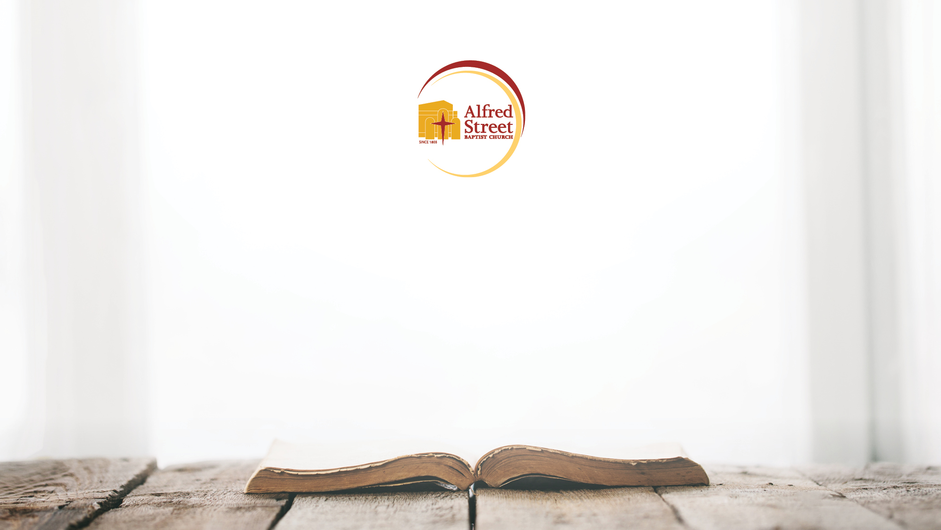
SEEK 2020
Taught by: Rev. Marc Lavarin

Slide 2
What is a fast?
Not specifically Christian
Recommendation not a requirement
Fasting is an opportunity for Christians to practice the fruit of self-discipline, by abstaining from personal pleasures and fixing their entire attention on God.
  TV,
  Technology
  Speaking (Silent Retreats)
  Finance
Notes:
In the most simple terms, fasting is abstaining from food; where we get breakfast
Not specifically Christian:
Hinduism – critical
Bahai – one month a year
Buddhism – during extreme meditations
Islam – Ramadan
Judaism – Yom Kippur, Tisha B’Av
“He said that the purpose of fasting is not just to eliminate something from your life, it's a way to replace it and supplement it with prayer. The reverend said fasting is a way for believers to redirect their attention back to God” Lavarin
What is Fasting:
Fasting is our way of HEARING GOD, because God is always speaking, the problem is that we are too distracted!
Fasting is hearing what God has always been saying
Its silencing the distraction or the things in our lives that prevent us from hearing from God to begin with!
If God is always speaking, what is preventing us from hearing God?
Recommendation not a requirement:
you may be shocked to find out that scripture does not require Christians to fast.
While scripture does not require Christians to fast, scripture does reveal the importance of fasting.
Other Ways to Fast:
Because fasting is a spiritual disciple that highlights the abstaining from personal pleasure, fasting is not only
Although many people will choose to abstain from food during their fast, food is not the only means of fasting. Believers can choose to abstain from anything that can potentially serve as a distraction in their pursuit of seeking God.
Because Fasting is not only about what you eat, you can choose to fast from anything that takes up and interferes with your walk with God, within reason.

Slide 3
Fasting in Other Religions
Hinduism – critical
Bahai – one month a year
Buddhism – during extreme meditations
Islam – Ramadan
Judaism – Yom Kippur, Tisha B’Av
Notes:
Per Pastor Wesley
Fasting is a spiritual discipline
The spiritual disciplines are those practices found in Scripture that promote spiritual growth among believers in the gospel of Jesus Christ. They are habits of devotion, habits of experiential Christianity that have been practiced by God’s people since biblical timese
Cooperate Disciplines
Confession of sins
Worship
Celebration
Seeking/Giving guidance
Inner Disciplines
Devotion/Meditation
Study
Prayer
Fasting

Slide 4
What Fasting is NOT:
Necessary for salvation – it is a work and therefore incapable of saving
A way of maneuvering or manipulating the will of God
A spiritual gift or badge of anointing/boasting (Mt. 6:16)
A diet
Notes:
From Pastor Wesley
We do not fast for piety, as a matter of Fact, Jesus directly rejects this type of fasting! Calls it out!
Its important to note, that as you enter into a fast, that God may not answer your prayers

Slide 5
Fasting that Pleases God
It is possible to fast incorrectly!
Fasting in Vain
  Story at Northeastern
Isaiah 58
Matthew 6:16-17
Notes:
Isaiah 58 Fasting that Pleases God:
Is not this the fast that I choose:
to loose the bonds of injustice,
to undo the thongs of the yoke,
to let the oppressed go free,
and to break every yoke?
⁷ Is it not to share your bread with the hungry,
and bring the homeless poor into your house;
when you see the naked, to cover them,
and not to hide yourself from your own kin?
When you fast, do not be somber like the hypocrites, for they disfigure their faces to show men they are fasting. Truly I tell you, they already have their full reward. 17But when you fast, anoint your head and wash your face, 18so that your fasting will not be obvious to men, but only to your Father, who is unseen. And your Father, who sees what is done in secret, will reward you.

Slide 6
Biblical Reasons to Fast
During critical and despairing times
  Jeremiah 26:9, Joel 1:14, Daniel 1:8
Preparation for assignments
  Matthew 4
Important decisions
  Acts 13:2; 14:23.
Spiritual Strengthen
  Mark 9:29
Notes:
Daniel 1:8 ⁸But Daniel resolved not to defile himself with the royal food and wine, and he asked the chief official for permission not to defile himself this way.
Joel 1:14 ¹⁴Declare a holy fast; call a sacred assembly. Summon the elders and all who live in the land to the house of the LORD your God, and cry out to the LORD.
Jeremiah 26:9 ⁹Why do you prophesy in the LORD's name that this house will be like Shiloh and this city will be desolate and deserted?" And all the people crowded around Jeremiah in the house of the LORD.
Acts 13:2 ²While they were worshiping the LORD and fasting, the Holy Spirit said, "Set apart for me Barnabas and Saul for the work to which I have called them."
Acts 14:23 ²³Paul and Barnabas appointed elders for them in each church and, with prayer and fasting, committed them to the LORD, in whom they had put their trust.
Other Examples
Ninevites: Jonah 3; Darius: Dan. 6; Cornelius: Acts 10
Benjamites: Jdg. 20; Ezra: Ezra 8
Daniel: Dan. 10; Israel: I Sam. 31
Israel: I Sam. 7; Isaiah 58
Esther 4,9; Ex. 34; Acts 14
Jesus: Matt. 4; Mark 9

Slide 7
Biblical Outcomes for a Fast
  Subdue the Flesh
  Strengthen the Spirit
  Discern the Will of God
  Solidarity with Believers
Notes:
Rom 7:15-25; 6:1-14
I Kings 19:9-18
John 10

Slide 8
Fasting & Prayer
Discerning God’s Will begins with Communication with God
Addition > Subtraction
Mark 9
Matter of Priorities
Notes:
Prayer is an important element of Fasting, the most important
In the Old Testament, it appears that fasting with prayer had to do with a sense of need and dependence, and/or of abject helplessness in the face of actual or anticipated calamity. Prayer and fasting are combined in the Old Testament in times of mourning, repentance, and/or deep spiritual need
Most people know the story of Mark 9
Jesus seems to be saying that a determined foe must be met with an equally determined faith. Prayer is a ready weapon in the spiritual battle (Ephesians 6:18), and fasting helps to focus prayer and give it resolve.
The theology of fasting is a theology of priorities in which believers are given the opportunity to express themselves in an undivided and intensive devotion to the Lord and to the concerns of spiritual life. This devotion will be expressed by abstaining for a short while from such normal and good things as food and drink, so as to enjoy a time of uninterrupted communion with our Father.
.

Slide 9
How to Fast
Prepare:
  Mentally, physically, spiritually
  Meals in advance
  Clearing your house of foods, electronics, others
Set Your Purpose and End Date
Addition Not Subtraction
  Prayer
  Journaling
  Meditation
Transformation > Perfection
Notes:
Before embarking on a fast, participants should prepare themselves mentally, physically, and spiritually. Keep in mind that fasting is not a form of dieting, and all participants should consult their primary care physicians before making any changes to their diet. We also suggest preparing your meals in advance, in order to maximize and focus your time and energy.
Remember, the objective of fasting is not only to eliminate things from your daily routine, but also to replace them with prayer. If you usually eat breakfast at a certain time of the day, spend that time in prayer instead. If you normally watch TV when you get home from work, consider replacing that activity with reading the word of God. As you fast, it is important to be consistent. However, if you break your fast by accident or even miss a few days, don’t beat yourself up or give up. Rather, get right back to your fasting objectives. Remember, the objective isn’t to be perfect, the objective is to be transformed.
What is at stake, what is your reason for doing something
Also, fasting should have a clear purpose. People in the Bible fasted and prayed because they wanted something specific to happen. They either wanted God to change them, to change their circumstances, or to reveal something to them. Ultimately, fasting is far more about focus than food. Fasting is taking your focus off of the things of this world in order to focus more on the things of God. Fasting can thus be a means of growing closer to God.

Slide 10
WHY SEEK?
Introduce the practice of an annual corporate fast
Unity within the body
Preparation for the year
Personal spiritual discipline
Notes:
Last year Pastor introduced Seek as a means to…
If you were hear last year before Pastor’s sabbatical you were here when Pastor mentioned the importance prayer… and wanting to incorporate prayer into the fabric of our church!
If you’ve paid attention, with the exception of 2nd Sunday, we’ve incorporated prayer into our service, to highlight the importance of prayer!

Slide 11
Seek 2019 REVIEW
4,000+ covenant partners
1,405 First Timers; 885 Online Community; 44 International
1,492 people participated in Daniel Fast
2,450 people turned off social media
$157,000 raised in SEEK 2019
Prayer Request
Notes:
Top Prayer Request
Peace
Home
Direction
Partners
Clarity
Debt
Faith
Guidance
Financial
Purpose
Fear
healing

Slide 12


Slide 13
Call to Fast
A message from Pastor Wesley

Slide 14
SEEK 2020
March 1 - 31, 2020
March Gladness (Fasting and Revival)
  Every Tuesday in March 03rd, 10th, 17th, 24th, 31st
Adult and Youth (NEW)
Devotional Journal (NEW)
Devotional Videos
3 components – Physical, Social, Financial
Notes:
We are launching into 31 days. That means we are adding 10 additional days. If you thought last year you were ready to quit, just wait until you finish this year! That means we are linking our fast to Lent, but not completely so!
This year, we are linking fasting and Revival!
We need EVERYONE to come out EVERY Tuesday! If you are fasting, you need to be at Revival!
We will be doing testimony service and prayers during March Gladness, so you need to make sure that you get there! It is going to be a great way of getting reenergized during the fast!
On March 31st, we are asking, all of our fasters to fill in this space because we are going to break the fast together, here at Alfred Street!
Asking everyone to wear their SELAH shirts on that day! More communications will be made leading up to this date! But its going to be a powerful night!
This year we’ve added both an Adult and Youth Version. That means that the youth and adults will be fasting at the same time! We are encouraging Families to Fast at the same time!
Devotional Journals are new, this year,
That means for each day, there will be a space in your journal for you to an answer a question.
This is intended to help you track your progress during the fast!

Slide 15
SEEK 2020
SELAH Word of the Day
Prayer Goals
  Week 1 | March 1 – 7 | 10 minutes a day
  Week 2 | March 8 – 14 | 20 minutes a day
  Week 3 | March 15 – 21 | 30 minutes a day
  Week 4 | March 22 – 28 | 40 minutes a day
  Week 5 | March 29 – 31 | 50 minutes a day
Journal Question
Notes:
In addition to your devotional, there is a SELAH word of the DAY.
This has been included as a means to incorporate our season of SELAH into our fast.
As you heard, Pastor will also be in SEEK with us as a congregation. And as a means of keeping our Pastor in our prayers, we’ve incorporated a SELAH word, that challenges you to meditate.
For example, the devotional topic may be LOVE and the SELAH word of the day will be REKINDLE. You then would get a journal question that will ask you a question about LOVE.
Additionally, we’ve added prayer goals!
We are working our way up to prayer!
Remember, this isn’t just about subtraction, but addition. So we are adding and working our way up in prayer!
Prayer Goals are set, for UNINTERRUPTED TIME!

Slide 16
SEEK 2020
Physical
  Daniel Fast
  12 Hours of Fasting
  Eliminate Sweets, Caffeine, Alcohol
Social
  No Social Media,
  No TV/Movies,
  Total of 1 Hour Per Day of Tech Use
Financial
  Daily Routine Purchases
  Non-Essential Personal items
  No Fast Food

Slide 17
SEEK 2020
Hidden Halo
  Amazing things happen when we say YES to God!

