Slide 1
Administrative Support Team

Slide 2
Who is Admin. Support? What do we do? How can we Help?

Slide 3
Who is Admin. Support?
Administrative Support Team is a group of individuals with many talents. We are team players for all of the many teams we Help.

Slide 4
What Do We Do?
We Are:
Receptionist
Mailroom Clerks
Weekend Front Desk Monitor
Local Print Shop (include but not limited to)
Name Tags, Certificates, Specialty Prints, etc.
And More……

Slide 5
How Can We HELP?
For All Print Request & Task Needs
There’s 3 Simple steps to get the job done
1. https://www.alfredstreet.org/
2. Hover over Member Needs & Click Leader Resources
3. Scroll Down & Click Admin Support Request Form

Slide 6
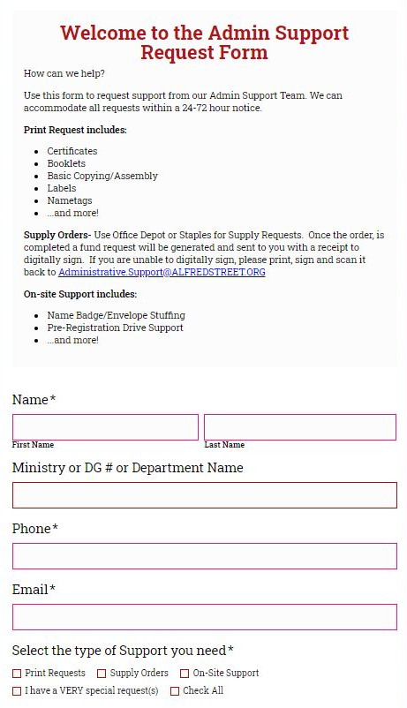

Slide 7
FAQ
Turnaround time
24-72 business hours. Business hours are Tuesday-Friday
9am – 6pm
How to receive project
ALL project are placed at the receptionist desk in building 325 with the recipient’s name and/ or ministry and/ or group
Updates/ changes/ edits/ add-on’s or removals
If there any of these please send an email to Administrative.Support@alfredstreet.org with your concerns

Slide 8
Now its your part to tell us…..
How can we HELP?

