Slide 1

An Authentic Life Series w/
Dr. LaTasha Morgan ©2025
-A 10 Week Wellness Group-
A journey to self-discovery, courage and authenticity to be who God PURPOSED you to be!
Alfred Street Baptist Church
Office of Christian Care and Counseling
Rev. Dr. Howard-John Wesley- Senior Pastor

Slide 2
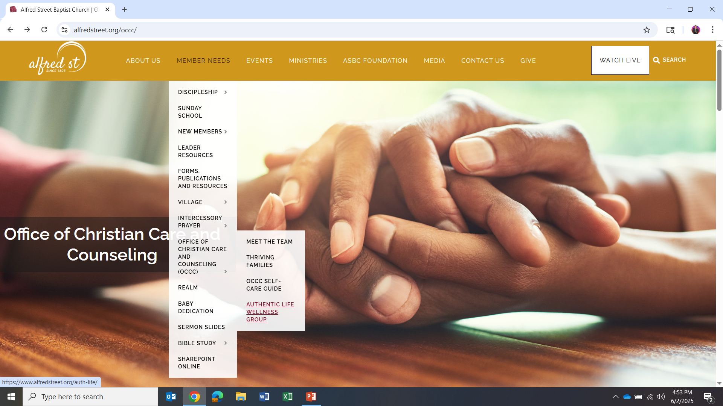
www. alfredstreet.org
Member needs
  Office of Christian Care and Counseling
    Authentic Life Wellness Group

Slide 3
-Chapter 3
Healing Insecurity and Unworthiness

Slide 4
Tools For the Journey (Chapter 1 Recap):
Gratitude
  Be more gracious towards you and your progress.
  Be grateful. Mindfulness (being present in the moment) as a practice can help.
Stop Overextending
  Monitor your generosity!
  BEAWARE here because on one hand you believe you are being a blessing and on the other hand you can dishonor yourself by constantly sowing into “TAKERS ONLY” soil.
  No is HOLY!
  Boundaries build self-compassion
Self-Understanding
  To cultivate self-compassion is to choose self-understanding over self-judgement.
  Learning to understand with grace is liberating! p.11
  HOMEWORK: Write a love letter to yourself…pg. 13)

Slide 5
Tools For the Journey (Chapter 2- Self Abandonment Recap):
How does Self-Abandonment Happen?
  Often it is due to learned behaviors
  Thrives on frequency, how often do you do this?
How does it show up?
  Pursuing Others and Things that do not align with your heart
  People-pleasing tendencies
  Hiding your true self or parts of you back.
  Lack of personal trust.
  Harsh judgement/criticism
What has it cost you?
  PEACE
  HEALTH
  SELF-EXPRESSION
  JOY
  LOVE
  YEARS OF YOUR LIFE!
  HOMEWORK: Vow to do 1 nourishing activity 1 x per week.

Slide 6
Karissa and Derrick’s Story…

Slide 7
Sacred Pause:
“Visualize yourself laying down the weights of insecurity and unworthiness that have blocked your love life.”
“See yourself dancing free with your heart open.”
“Imagine yourself standing in the truth that you are worthy of love from yourself and others.”

Slide 8
The Root of Insecurity and Unworthiness
Early critical voices that shamed you…
  Not, good, cute, smart, talented (enough)…
  Peers, strangers, relatives, teachers
  THE CRITICAL VOICE DID NOT START IN YOU!
    “nothing is wrong with you- but something has happened to you”
The above impacted your self-esteem
  Multi-domains of self-esteem (READ Pg. 26-27)
    Intellect
    Appearance
    Talents & Abilities
    Social
    Personal- Love of self
    External Relationships- Love with/towards others
    ?Am I worthy of Love if I haven’t experienced love in an intimate relationship?

Slide 9
Release Comparison
Comparison is a Super Power if you use it. It will either drive you crazy causing you to overlook the gift that you are by hyper-coveting what someone else supposedly has. Or, it will allow you to view your circumstances with a new perspective in that “there is no “race,” but rather there is a starting line.” Dr. Morgan & Mel Robins
Dr. Thema’s take…
“Don’t make other people your thermometer. Instead, pay attention to the voice within you that will let you know how you feel and make space to cultivate the behavior you desire for yourself-minus the effort of trying to duplicate their actions.

Slide 10
Shift Your Focus
{Insecurity is fed by focusing on…}
Weaknesses
YOU are worthy of a new story, not a negative self-fulfilling prophecy!
Mistakes
What aspects of your life do you focus your time and energy on?
Lowest Moments

Slide 11
Shift Your Focus cont’d…
Sacred Pause:
Consider the things you appreciate about yourself:
Strengths
Positive qualities
Growth Areas
Now, REFLECT.
Reflect on times you have been loving, kind, thoughtful, and caring.
This is important because insecurity makes you highlight your shortcomings and ignore your strengths!
You are more than your mistakes. Forgive yourself and free yourself to be your own friend (p. 29).

Slide 12
Holding Yourself Hostage?
Done something you are ashamed of? Something you believe God is angry with you about? Feel that you should not have joy, ease, pleasure, etc. because of it/them?
If you answered YES, then- you are holding yourself hostage based on experiences in your past. This is not portion- ESPECIALLY FOR THE BELIEVER. Romans 8:31-39- teaches us that NOTHING can separate us from God’s love.
  What separated or disqualified you from love? THIS has to be released so you can embrace love.
  STOP punishing yourself. Give yourself permission and grace to let love flow to and from you.
  And, it doesn’t matter how old you are- love is still possible. First, though you have to learn how to show up for yourself with love and begin with giving yourself the love you never received.

Slide 13
Address Insecurity by examining cognitive distortions…
Cognitive Distortions- The negative, toxic, hindering beliefs that form and override our sense of safety and ability to make fruitful choices.
Where to start?
Name the lies that drive your insecurity and sense of unworthiness.
Look for evidence for and against these beliefs so you can dismantle them.
Affirm that you will not let insecurity sabotage your relationships.
Instead of abandoning yourself, you can let go of being reactive, defensive, combative. Be settled with the you- you are.

Slide 14
Homework (p. 33)
Activation Exercise #1- Complete the following sentence 3 times.
I release the lie that ________________________________________________.
I affirm that ________________________________________________________.
Activation Exercise #2- Complete this poem by filling in the blanks.
My heart is healing, growing, and ____________________________________.
I attract love into my life with my _____________________________________.
I pour love into those I care about with ________________, _________________ sings my worthiness. ______________________________ whispers my worthiness.
Affirmation: If it aligns with you, embrace yourself and read your poem aloud to yourself or to someone you feel comfortable sharing it with.

